Slide 1

jobs

Slide 2
What is a Jenkins Job?
A Jenkins project (job) is a repeatable build job, which contains steps and post-build actions
A job can do anything - depending on what you configure it to do
An example of what a job can be used to do is automatically build a project and deploy it on a server, to be accessed over the internet

Slide 3
How to Create a new job
To create a new job, you can navigate to the New Item link on the Jenkins dashboard
This will then present you with some options for what type of job to create
Go ahead and name your job first-job, select Freestyle Project and then select OK

Slide 4
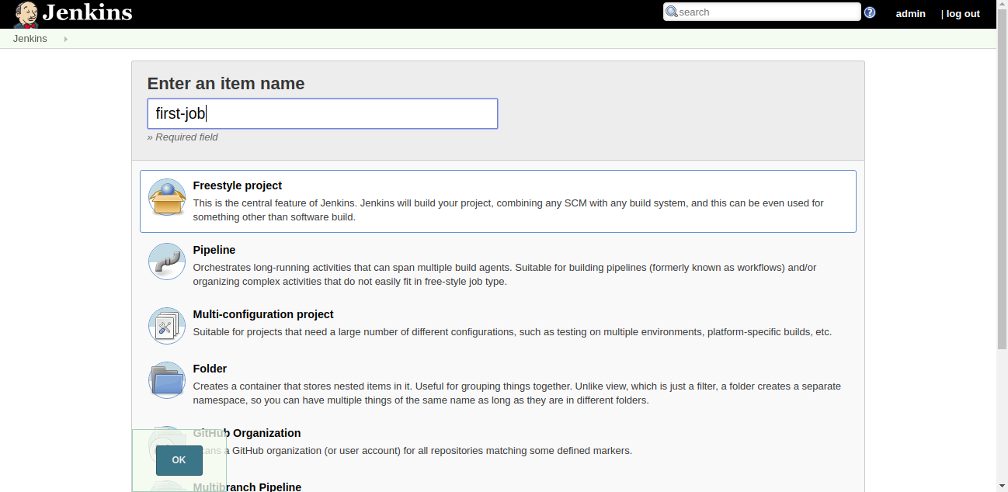
How to Create a new job
Have a look at the learner guide for all the different options with jobs

Slide 5
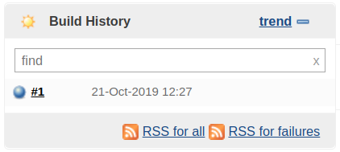
builds
A build is a result of an execution of a project (job) in Jenkins
Builds for projects can be seen on the Build History section of the project dashboard:

Slide 6
Build status
Success
The build succeeded
If all the build steps complete successfully, this will be the build status.
Failure
The build failed
If any of the steps exit with a non-zero status (if they throw an error), then the build status will go to failed.

Slide 7
Build status
Aborted:
The build aborted before it finished
This exit status is more uncommon; it must be set either by yourself or plugins that are being used in the project
Build steps
Build steps are effectively where you configure what your job is going to do. Depending on your situation, this could accomplish many different tasks:

Slide 8
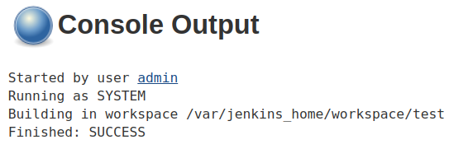
Console Output
The console output is likely one of the main parts of a build that you'll be checking for information and debugging purposes
This section includes the output for any shell scripts and plugins that have been executed in the build step for a project

Slide 9
Freestyle Job
Installation and adoption
Likely to be a long and involved process
Potential to waste time, effort, and money should it be approached without enough planning
Learning curve
Pipelines make use of many different and relatively new technologies that teams may not have any prior experience with
New workflow
Some teams may find their old responsibilities obsolete and have to readjust their set of responsibilities

